Slide 1


Truss project Presentation
Presented To:
Ma’am Qurat-ul-Ain
Presented By:
2021-MC-12 Dayan Hafeez
2021-MC-16 Muhammad Usman Noor
&

Slide 2
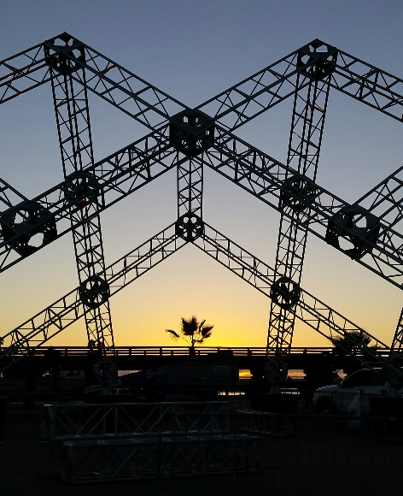
Trusses & bridges
A Truss is an important structure type in structural engineering. So what are trusses? A Truss is a triangulated system of members that are structured and connected in a way such that they only incur axial force. These members are considered two-force members as the forces are only applied at either end of the member
When designed correctly, trusses are an efficient way to span long distances while minimizing the amount of material used.

Slide 3
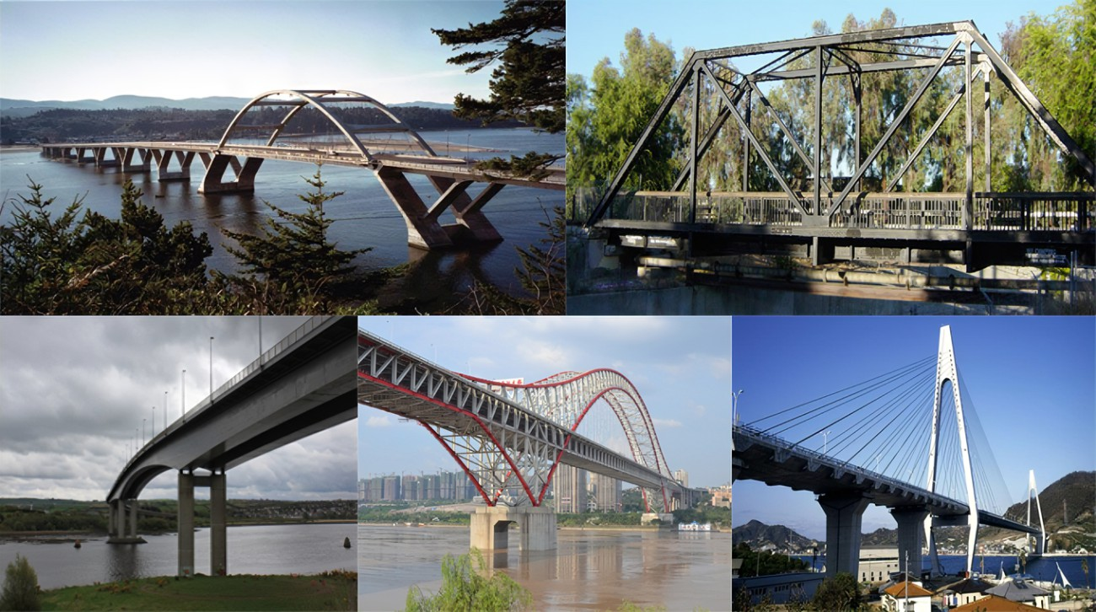
Types of truss bridge :
Commonly used truss designs are:
Howe truss
Pratt truss
K truss
Warren truss
Baltimore truss etc…

Slide 4

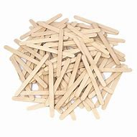

Our Goal
The Bridge has to be strong, firm & steady
It has to attractive
Minimum use of Sticks

Slide 5
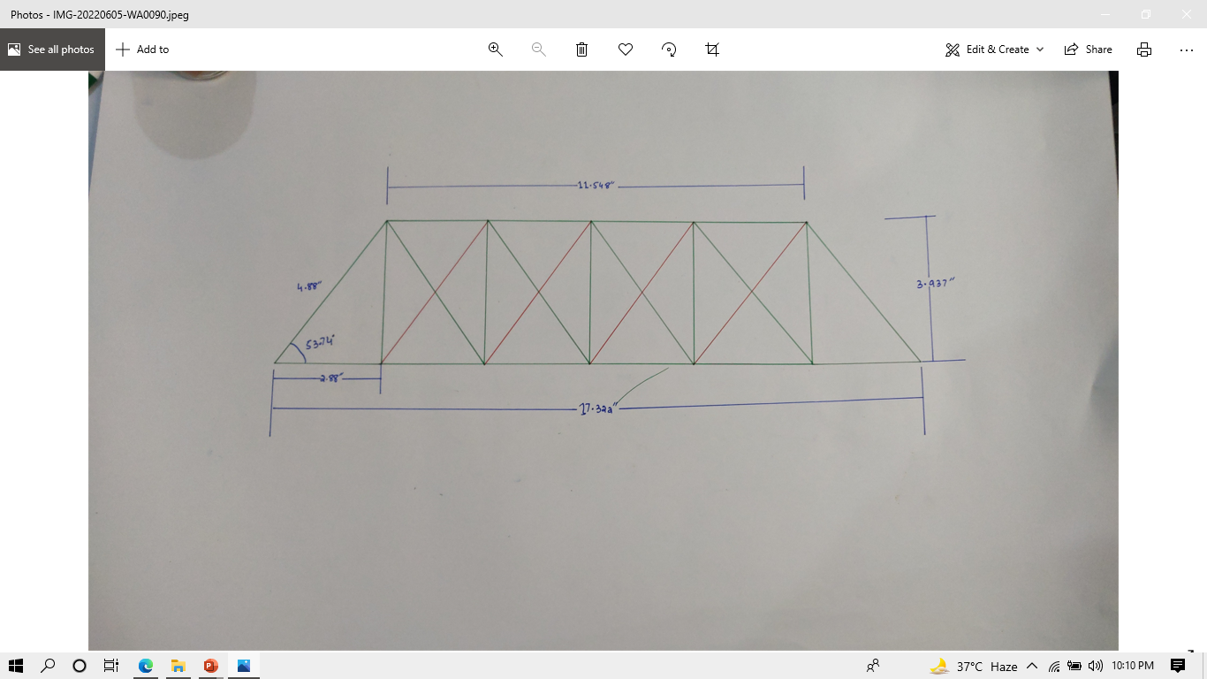
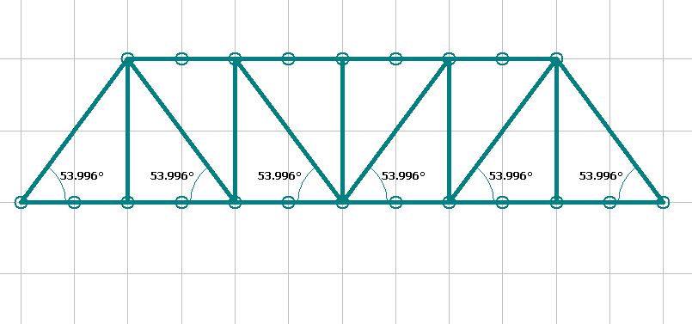

Our Design
It is basically based on
“PRATT”
Design
But it is some what like this
But What These Red Lines Are Doing In “PRATT”

Slide 6

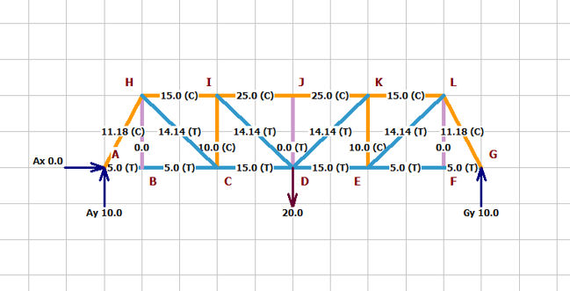
The Answer of above question is simple
“ FOR EXTRA STABILITY WE ADD THESE ZERO FORCE MEMBER”
So in Calculations AND Diagram we will not add them because they make the
Bridge “statically indeterminate”

Slide 7
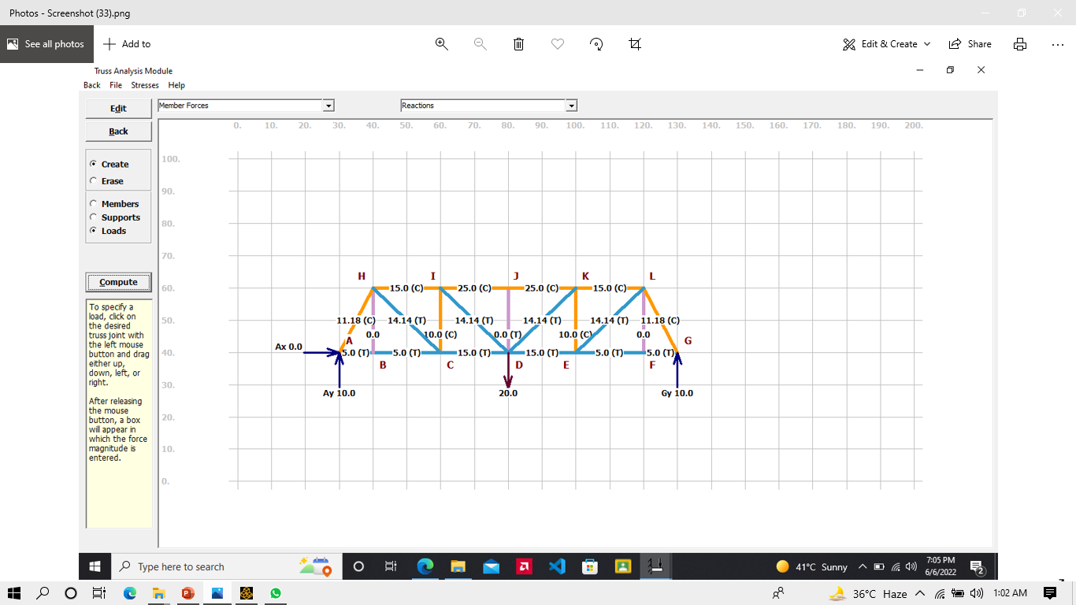

Slide 8
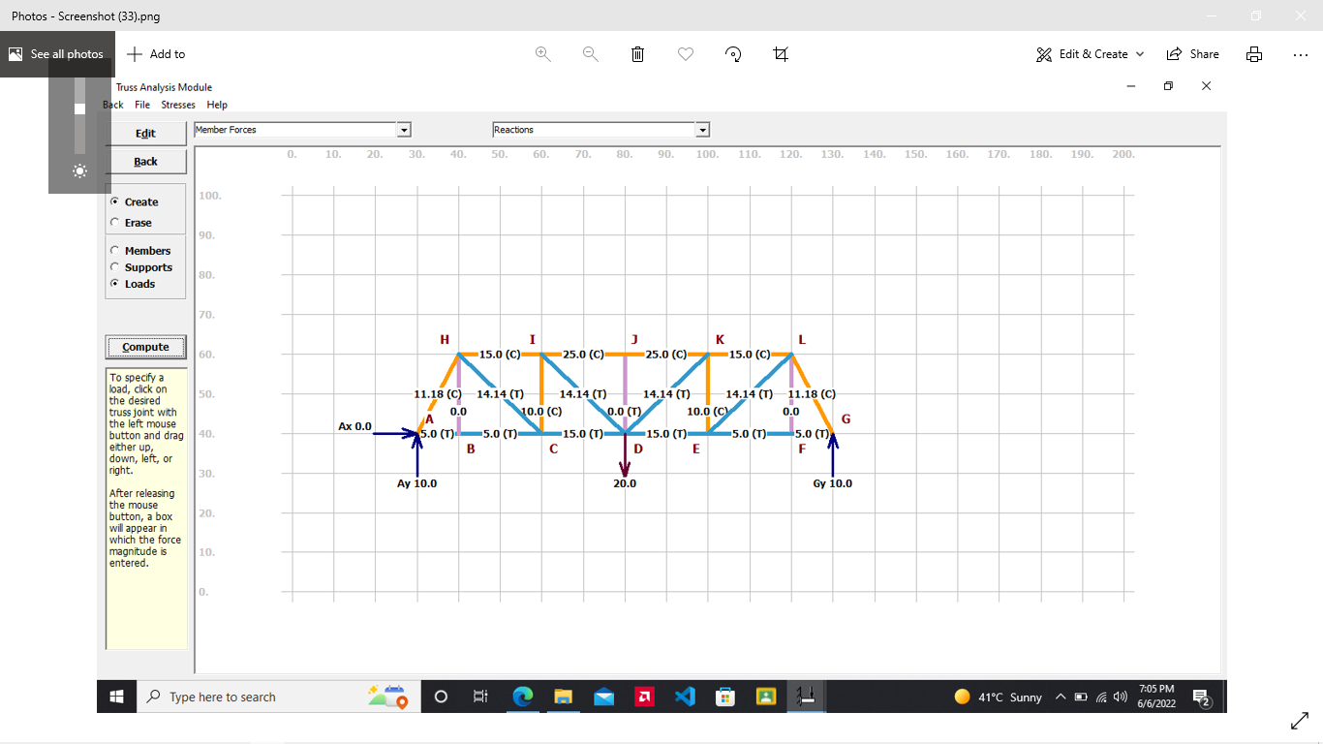
Calculation & Analyses
Equilibrium condition for space TRUSSES
ΣF_{x} =0
ΣF_{y} =0
ΣF_{z} =0
ΣM_{x} =0
ΣM_{y} =0
ΣM_{z} =0

Slide 9
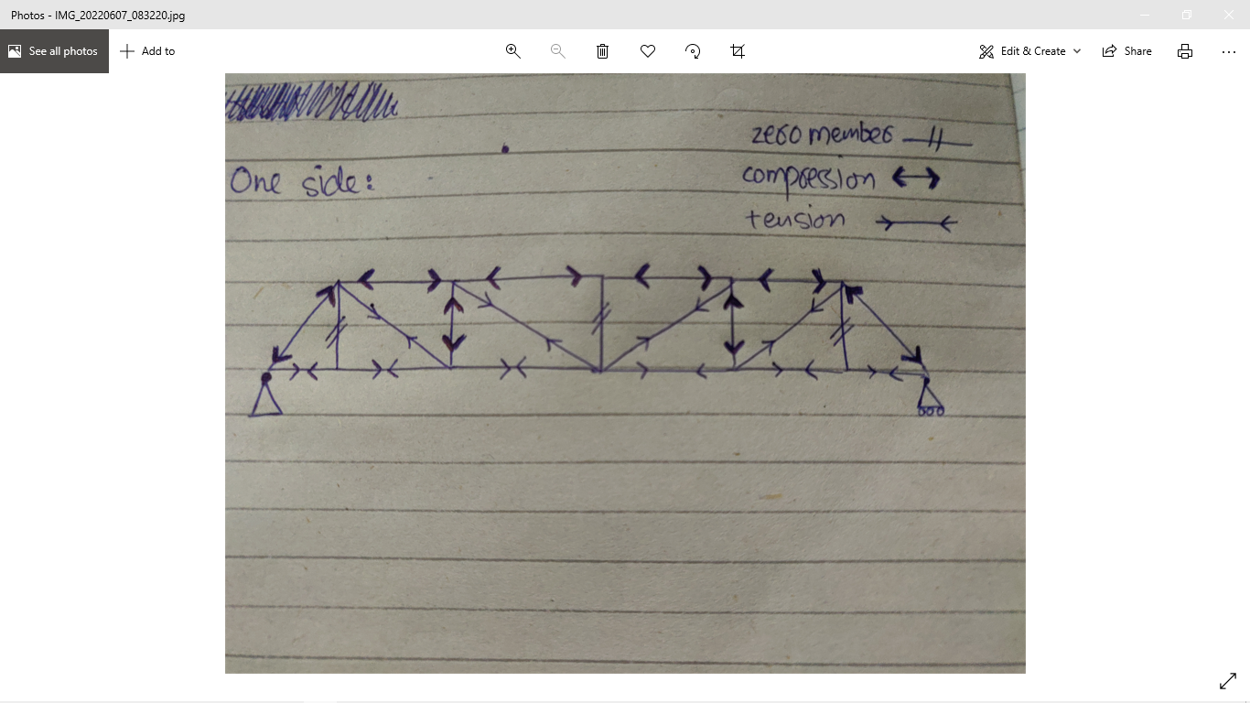
So,
GL= -031L (C), GF= 0.1845L (T), EF=0.184L (T)
LK=-0.369L (C), LE=0.31L (C), EK=-0.249L (C)
ED=0.369L(T), KD=0.31L(T), KJ=-0.5535L(C)
Zero Member ≠
Compression ←→
Tension →−←
We find the general Forces in terms of Load
The load will depend on the Stick

Slide 10
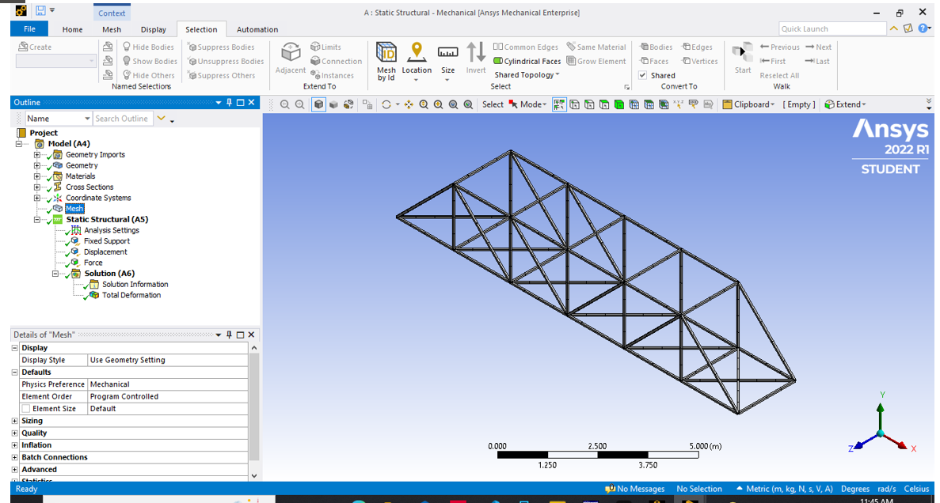
FEA Analysis
-We did our FEA analysis on Ansys Workbench Mechanical
Final Meshed Model:

Slide 11
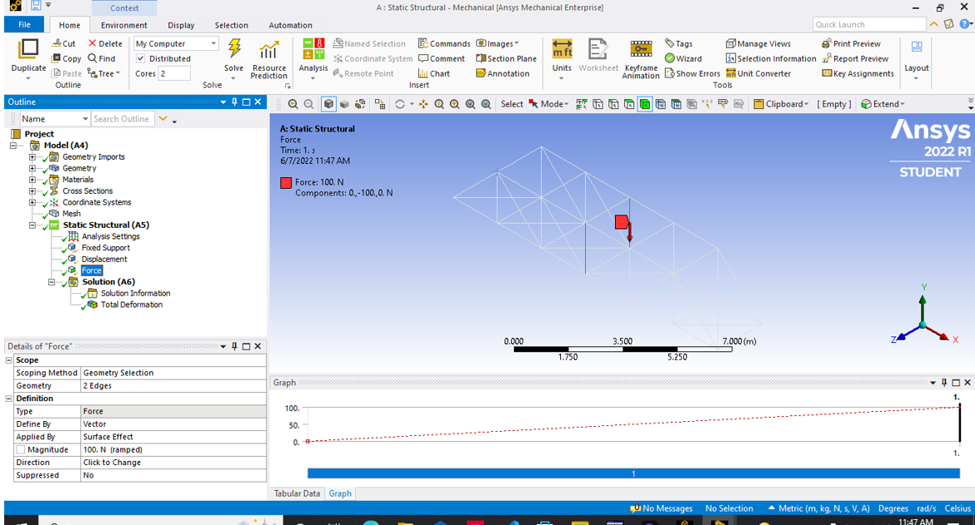
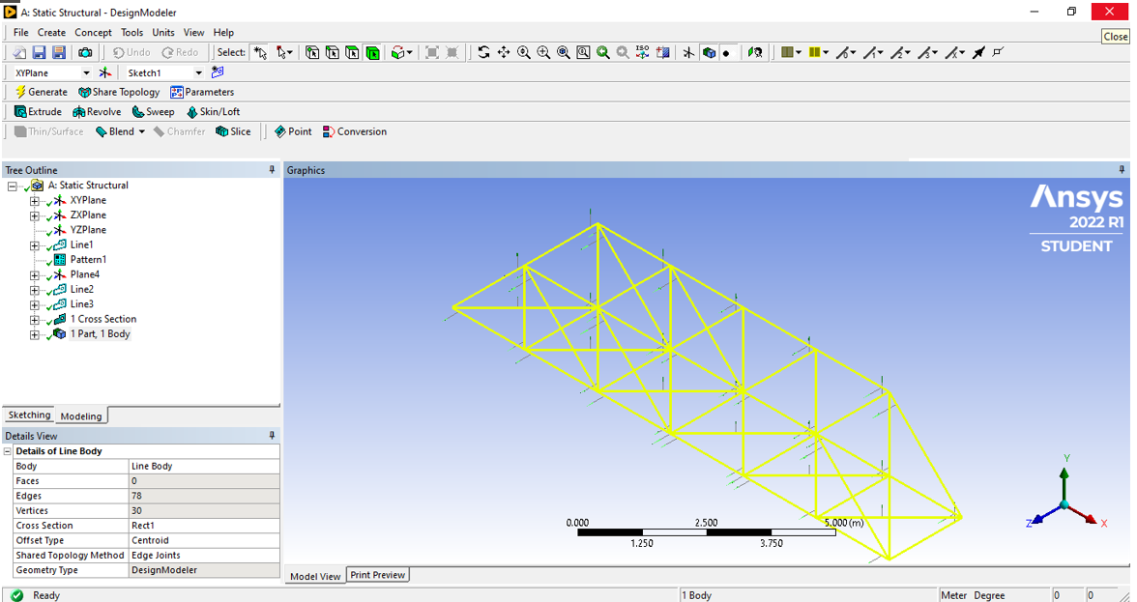
FEA Analysis
-We define our constrain and loads

Slide 12
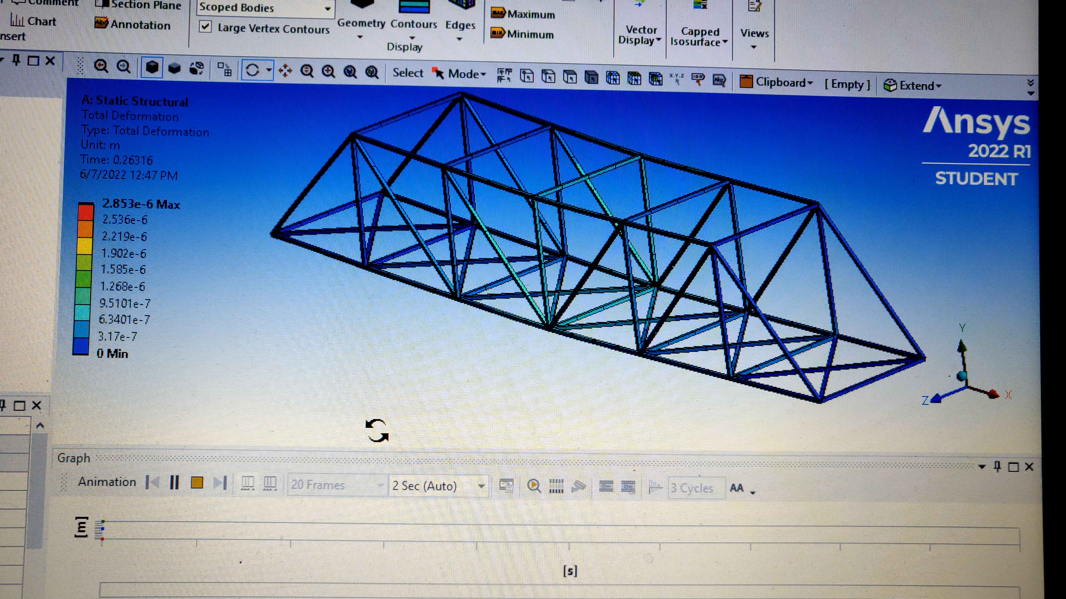
FEA Analysis
Total deformation Solution:

Slide 13
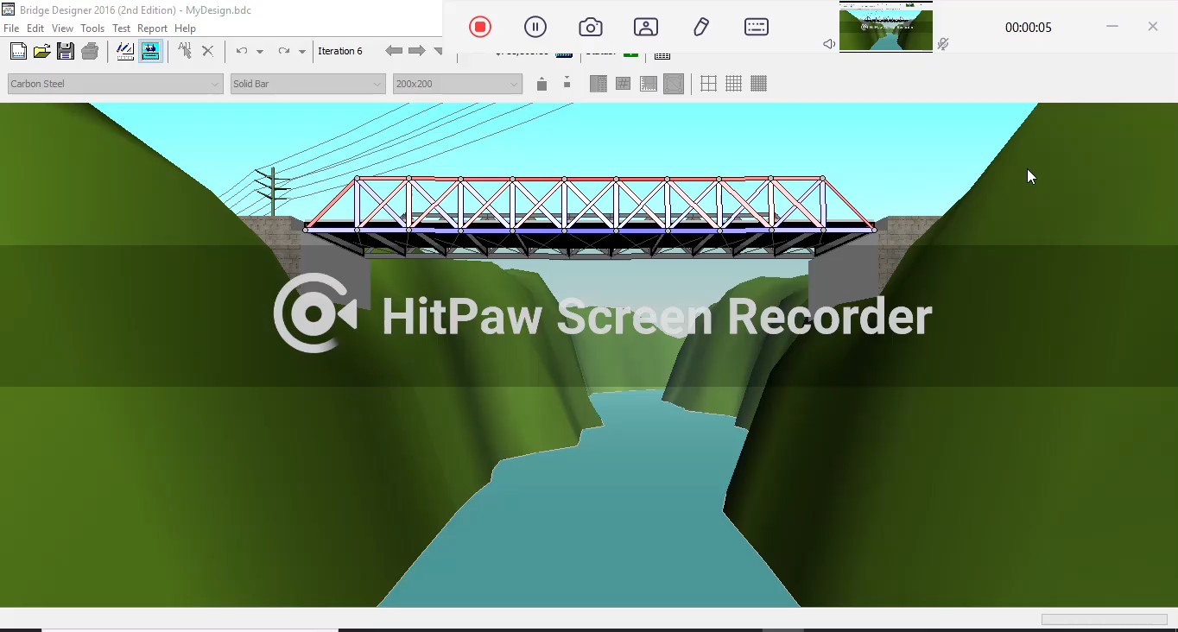
Analysis
West Point Bridge Designer

Slide 14
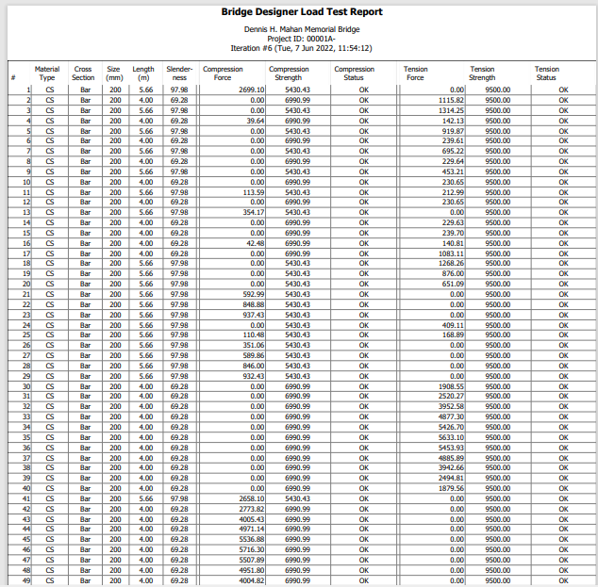
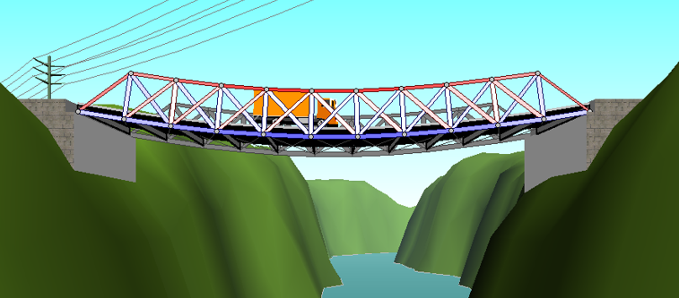
Prediction Of Failure
Exaggerated view

Slide 15
Advantages:
It is a Simple Design
Higher load to mass ratio
The diagonal members are in Tension as compared to Howe truss
It is more stable
It is very similar to Howe
Effective for compression force
Useful weight Distribution
Efficient force Dissipation
Disadvantages:
Not aesthetically pleasing
It is not ideal for all situations as it does not address shear loads

Slide 16
Difficulties Faced:
It was difficult to calculate the space truss
3D Modeling of bridge was difficult and time taking
Running the FEA Meshing & Deformation solutions were difficult
Figuring out what the loads should be for different thickness of sticks

Slide 17
Resources Used:
Software used:
Ansys Workbench Mechanical
West point bridge designer
MD Solids
References:
https://youtu.be/J0cCA1PAINU
Truss – Wikipedia
https://www.bing.com/search?q=truss&cvid=19b32f25e2b14420bb64a15cd0f253ab&aqs=edge.0.69i59j0l6j69i60l2.851j0j4&FORM=ANAB01&PC=EDGEDB
What is the difference between space frame and space truss? (herbertinter.com)

